Slide 1
Linked Lists

Slide 2
Linked List Basics
Linked lists and arrays are similar since they both store collections of data.
The array's features uses the strategy of allocating the memory for all its elements in one block of memory.
Linked lists use an entirely different strategy: linked lists allocate memory for each element separately and only when necessary.

Slide 3
Disadvantages of Arrays
The size of the array is fixed.
Inserting (and deleting) elements into the middle of the array is potentially expensive because existing elements need to be shifted over to make room

Slide 4
Linked lists
Linked lists are appropriate when the number of data elements to be represented in the data structure at once is unpredictable.
Linked lists are dynamic, so the length of a list can increase or decrease as necessary.
Each node does not necessarily follow the previous one physically in the memory.
Linked lists can be maintained in sorted order by inserting or deleting an element at the proper point in the list.

Slide 5
Singly Linked Lists
head
next
next
next
next
a
b
c
d
First node
Last node

Slide 6
Singly Linked List
HEAD
1023
1
2
3
4
×
2201
1423
3213
1023
2201
1423
3213

Slide 7
Empty List
Empty Linked list is a single pointer having the value of NULL.
HEAD = NULL

Slide 8
Basic Linked List Operations
List Traversal
Searching a node
Insert a node
Delete a node

Slide 9
Insertion in a linked list
…
a
b
…
3
4
2
current
1
x
tmp
1. tmp = new Node
2. tmp.data = x
3. tmp.next = current.next
4. current.next = tmp;

Slide 10
Deletion from a linked list
…
a
x
b
…
current

Slide 11
Singly Linked List

Slide 12
Operations in Singly Linked List
Traversing
Searching
Insertion at the beginning/Head
Insertion at the end
Insertion after a given node value
Deletion at the beginning/Head
Deletion at the end
Deletion of a given node value

Slide 13
Traversing/printing a linked list
Traverse(HEAD)
Step 1: If HEAD == NULL then
PRINT “No elements”
Else
SET PTR = HEAD
Repeat while PTR != NULL do
Print PTR.DATA
PTR = PTR.NEXT
Done
Step 2: EXIT

Slide 14
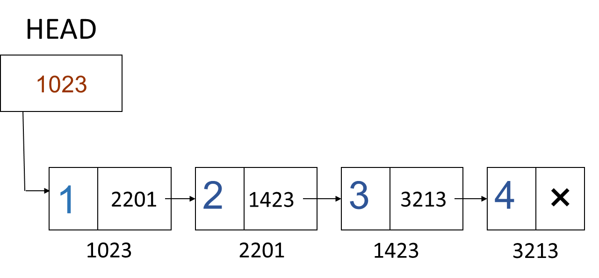
Inserting a new node in the beginning of the linked list
InsertAtHead(HEAD, val)
Step 1: //Initialize New_Node, New_Node.DATA = VAL New_Node.Next=Null
Step 2: New_Node.next = HEAD
Step 3: HEAD = New_node
Step 4. Exit

Slide 15
Singly Linked List - Insert at end
HEAD
PTR
New node
1023
1
2
3
4
×
5
×
2201
1423
3213
2112
1023
2201
1423
3213
2112

Slide 16
Inserting a new node in the end of linked list
InsertAtEnd(HEAD,val)
Step 1: //Initialize New_Node
New_Node.DATA = val
New_Node.Next = NULL
Step 2: If HEAD == Null then
HEAD = New_Node
Else
SET PTR = HEAD
Repeat while PTR.NEXT != NULL
SET PTR = PTR.NEXT
Done
SET PTR.NEXT = New_Node
Step 3: EXIT

Slide 17
Inserting a new node after a node that has value NUM
InsertAfterNum(num,val)
Step 1: Initialize New_Node,
New_Node.DATA = val, New_Node.Next = NULL
Step 2: If HEAD == Null then
PRINT “No elements”
Exit
End If
Step 3: SET PTR = HEAD
Step 4: Repeat while PTR!=Null AND PTR.DATA != num do
SET PTR = PTR.NEXT
Done
Step 5: If PTR == NULL then
PRINT “NUM not found”
Else
SET New_Node.NEXT = PTR.NEXT
SET PTR.NEXT = New_Node
EndIf
Step 6: EXIT

Slide 18
Deleting the first node from the linked list
Step 1: IF Head == NULL, then
Write UNDERFLOW
Exit
End If
Step 2: SET Head = Head.NEXT
Step 3: EXIT

Slide 19
Deleting the last node of the linked list
DEL_LAST (HEAD)
Step 1: IF Head == NULL, then
Write UNDERFLOW
Exit
EndIf
Step 2: If HEAD.Next == NULL then
HEAD = NULL
Exit
EndIf
Step 3: SET PTR, PREPTR = Head
Step 4: Repeat while PTR.NEXT != NULL do
SET PREPTR = PTR //PREPTR will point to second last node
SET PTR = PTR.NEXT
Done
Step 6: SET PREPTR.NEXT = NULL
Step 7: EXIT

Slide 20
Deleting a given node value from the linked list
DEL_NODE(HEAD,VAL)
Step 1: IF Head == NULL, then
Write UNDERFLOW
Exit
EndIf
Step 2: SET PTR, PREPTR = HEAD
Step 3: Repeat while PTR!= NULL AND PTR.Data!=VAL do
SET PREPTR = PTR
PTR=PTR.NEXT
Done
Step 4: If PTR == Null then
PRINT “VAL not found”
Exit
ElseIf PTR == HEAD then // deletion at beg
Set HEAD = HEAD.Next
Else // deletion at any other node or last node
SET PREPTR.NEXT=PTR.NEXT
EndIf
Step 5: EXIT

Slide 21





Print n elements of the singly linked list.
Set PTR = HEAD
Repeat While PTR != NULL do
PRINT PTR.Data
PTR = PTR.Next

Slide 22
Doubly Linked List

Slide 23
Doubly Linked Lists
Head
×
A
B
C
×
Advantages:
Convenient to traverse the list backwards.
Simplifies insertion and deletion because you no longer have to refer to the previous node.
Disadvantage:
Increase in space requirements.

Slide 25





































Slide 26











































Slide 27
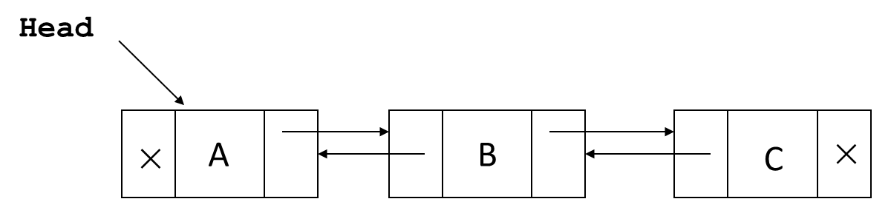
Inserting a new node at the front of Doubly linked list
Step 1. NEW.Data = VAL, NEW.Next = NULL, NEW. Prev = NULL
Step 2. NEW.Next = HEAD
Step 3. HEAD.Prev = NEW
Step 4. HEAD = NEW

Slide 28













Inserting a new node at the end of Doubly linked list
INSERT_END (HEAD, VAL)
Step 1: Initialize New_Node,
New_Node.DATA = VAL, New_Node.Next= NULL, New_Node.Prev = NULL
Step 2: If HEAD == Null then
SET HEAD = New_Node
Exit
End If
Step 3: SET PTR = HEAD
Step 4: Repeat while PTR.NEXT != NULL do
SET PTR = PTR.NEXT
Done
Step 5: SET PTR.NEXT = New_Node
Step 6: SET New_Node.Prev = PTR
Step 7: EXIT

Slide 29

Inserting a new node at the end of Doubly linked list
INSERT_HEAD (HEAD, VAL)
Step 1: Initialize New_Node,
New_Node.DATA = VAL, New_Node.Next= NULL, New_Node.Prev = NULL
Step 2: If HEAD == Null then
SET HEAD = New_Node
Exit
End If
Step 3: PTR = HEAD
Step 4. Repeat While PTR.Next!= NULL do
PTR = PTR.Next
Done
Step 5. PTR.Next = NEW
Step 6. NEW.Prev = PTR
Step 7. Exit

Slide 30










Slide 31













Delete the first node of Doubly linked list
Delete_First(HEAD)
Step 1: IF Head == NULL, then
Write UNDERFLOW
Exit
EndIf
Step 2:

Slide 32











Slide 33
Deletion
current
a
b
c
1. current.prev.next = current.next
2. current.next.prev = current.prev

Slide 34
Delete a given node in a doubly linked list
DEL_NODE(HEAD,VAL)
Step 1: IF Head == NULL, then
Write UNDERFLOW
Exit
EndIf
Step 2: SET PTR, PREPTR = HEAD
Step 3: Repeat while PTR!= NULL AND PTR.Data!=VAL do
SET PREPTR = PTR
PTR=PTR.NEXT
Done
Step 4: If PTR == Null then
PRINT “VAL not found”
Exit
ElseIf PTR == HEAD then // deletion of the first and only node
If HEAD.Next !=NULL then
Set HEAD.Next.Prev = Null
End If
Set HEAD = HEAD.Next
Else
If PTR.Next!=Null then
Set PTR.Next.Prev = PTR.Prev
EndIf
SET PREPTR.NEXT=PTR.NEXT
EndIf
Step 5: EXIT

Slide 35
Practice Questions

Slide 36
Ques 1. The situation when in a linked list HEAD = NULL is:
A. underflow
B. overflow
C. housefull
D. saturated
Ques 2. Each node in a linked list must contain at least …..
A. Three fields
B. Two fields
C. Four fields
D. Five fields
Ques 3.. Linked lists are best suited …..
A. for relatively permanent collections of data.
B. for the size of the structure and the data are constantly changing.
C. data structure
D. for none of above situation

Slide 37



